Slide 1

Bridging the Moore’s Law
Performance Gap with Innovation Scaling
Todd Austin
University of Michigan
Notes:
New slides?
- slide on 10 years ago? To gauge our changes?
- slide on “Advice for Pis”
- Work 10 years out, take the risk, the center will support you
- Put your best work in the center, the center will support you
- Collaborate, take the opportunity, it will provide benefits
- Work with (not for) your sponsors, stakeholders can provide excellent insight and support

Slide 2
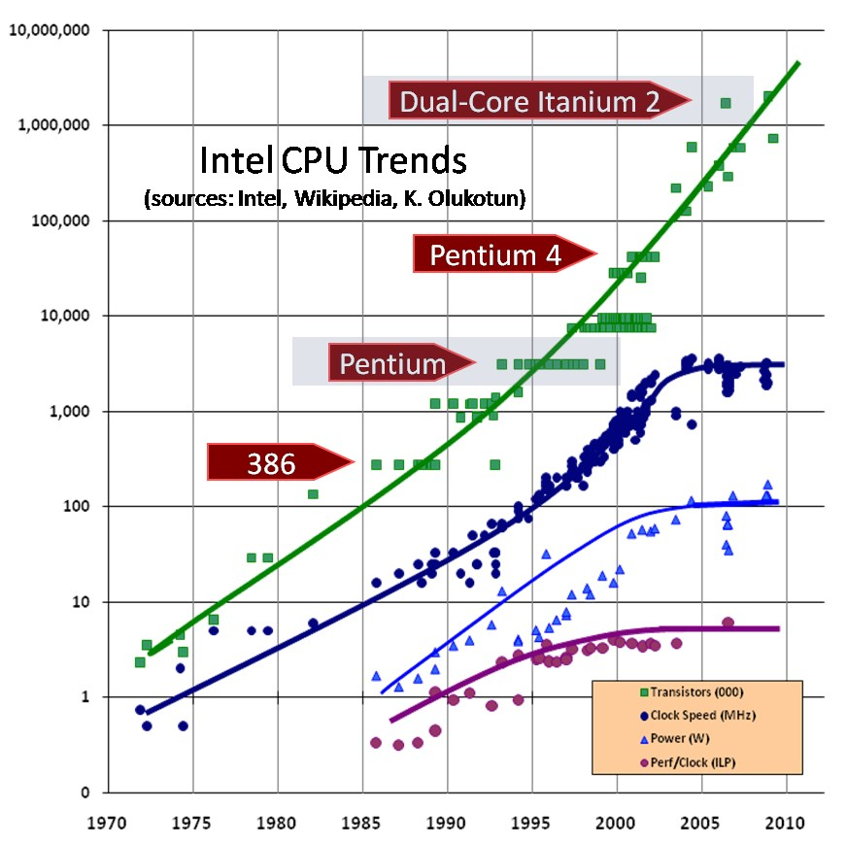
Moore’s Law Performance Gap
Today, gap is
cresting 10x

Slide 3


Slide 4
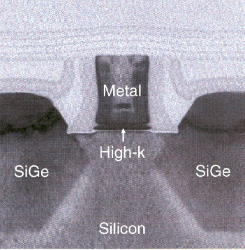
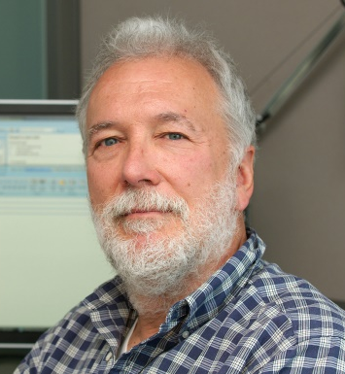
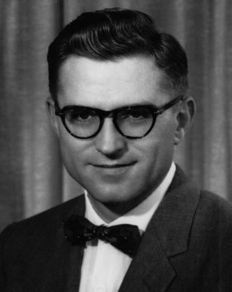

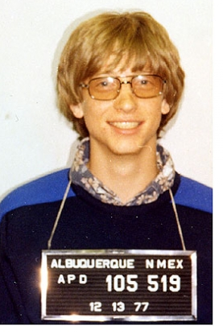

We Investigate: Who’s to Blame?
?

Slide 5
The Programmer?
Some say programmers cannot overcome
hard parallel programming problems
Not the case, as parallel programming techniques and infrastructure is advancing more quickly than ever before
  Map-reduce
  Hadoop
  Spark
  NoSQL databases
  Memcached
  Cassandra

Slide 6
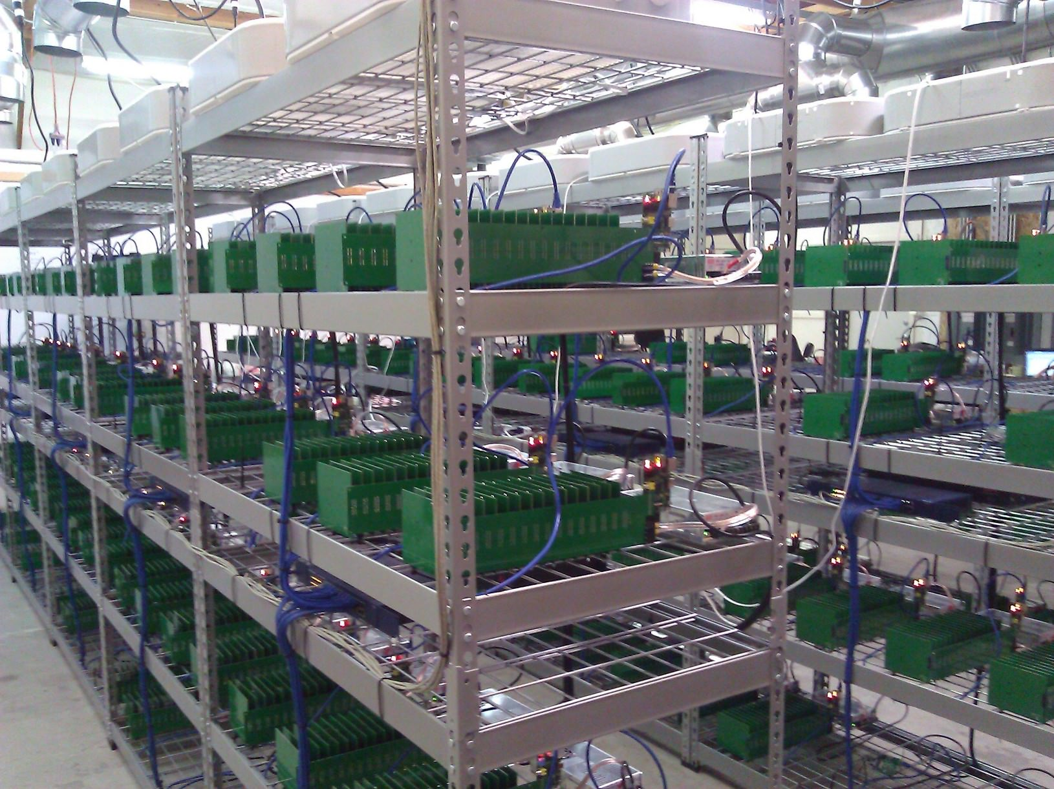
Largest NA Bitcoin Miner
GPGPU-based system
Fills 2000 sq.ft. warehouse
Computes 1 petahash/s
Reportedly generates $8M in Bitcoins per month
Unfortunately soon to be obsolete as Bitcoin difficulty continues to scale

Slide 7
The Educator?
Perhaps CS education is failing to educate
Not the case, CS education is booming
  @ Michigan CS enrollments are up nearly 250% from 5 years ago
  Average entrant GPA’s are up as well
Quality of CS education is on an upward trend
  Among the highest ranked educators by students (@ Michigan)
  Young area has less “dead wood” than our more venerable engineering counterparts
  Active-learning approach to education is the norm for CS in the US

Slide 8
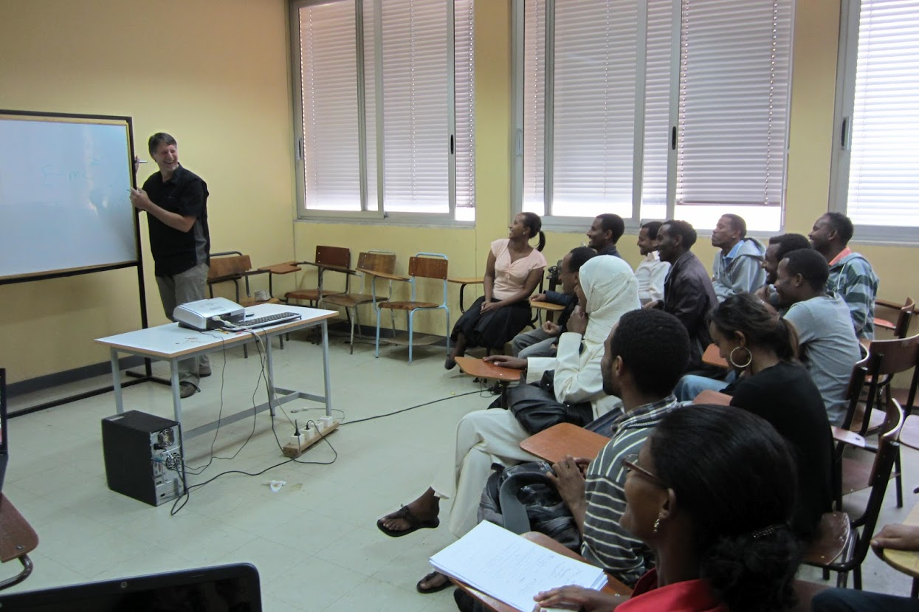
CS Education in Ethiopia
I have been working with Addis Ababa Institute of Technology to develop CS and IT coursework since 2008
Special focus on building
infrastructure and
developing active learning
Nearly 600 students
in the CS program
2nd most popular major
in the university
  With many job opportunities
  The first?

Slide 9
Silicon Technology?
Are transistors failing us, in the past scaling
decreased latency, power, cost
Yes in part, silicon scaling has stalled for gate oxide layers
  Due to leakage concerns, gate oxide scaling has stopped
  This leaves threshold voltages high and prevents large decreases in V_{dd}
Because scaling has become uneven with the transistor
  Dennard scaling has all but stopped
  But, silicon is still bringing more transistors every generation, and will continue for perhaps a decade or so
Ultimately creates the dark silicon dilemma
  Which prevents all of the chip to be active at the same time

Slide 10
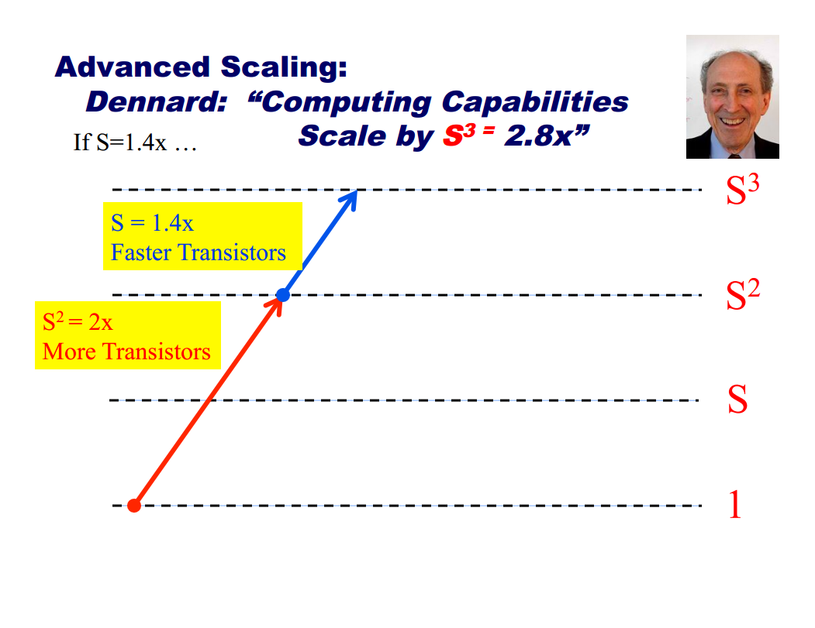
The Dark Silicon Dilemma
Courtesy Michael Taylor @ UCSD

Slide 11
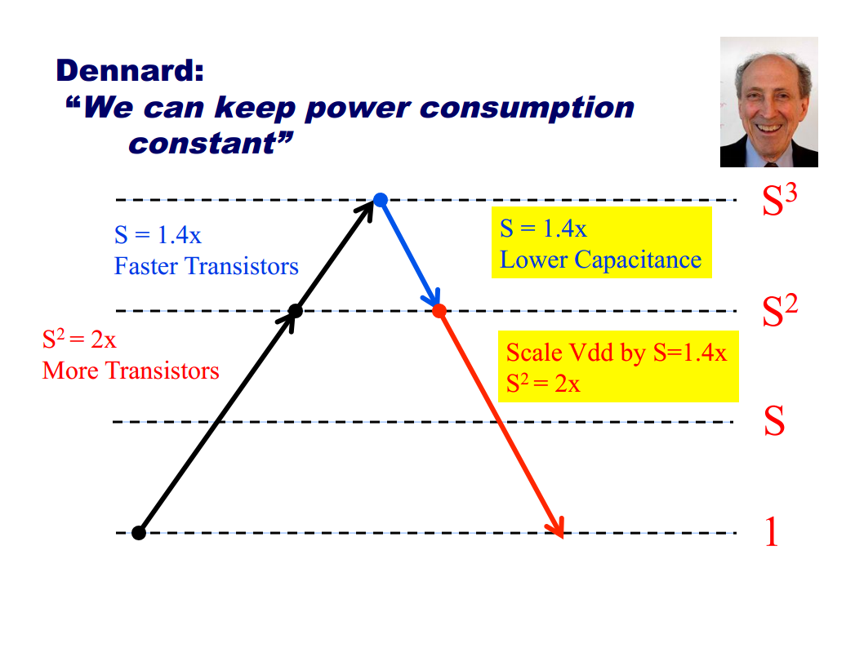
The Dark Silicon Dilemma
Courtesy Michael Taylor @ UCSD

Slide 12
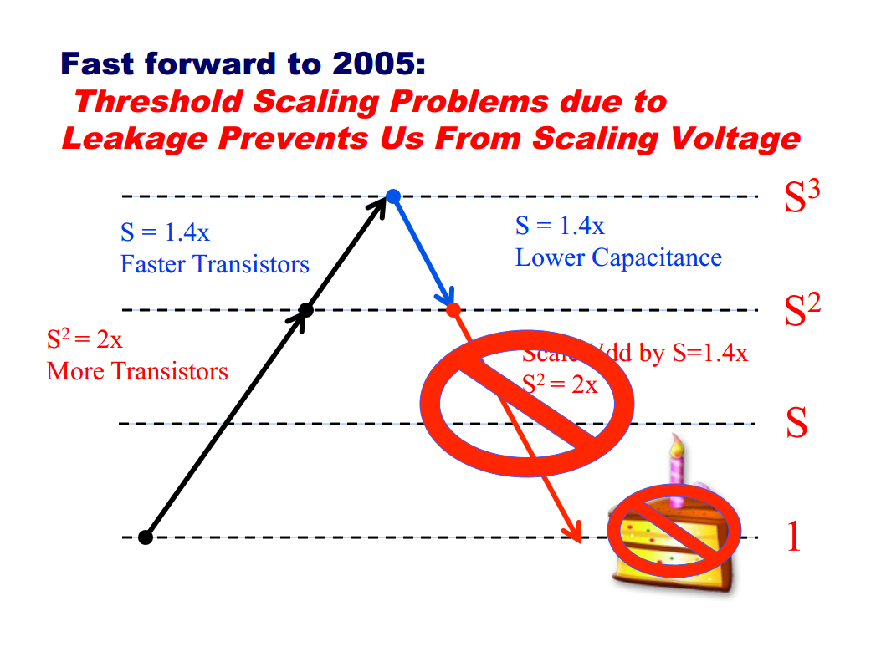
The Dark Silicon Dilemma
Courtesy Michael Taylor @ UCSD

Slide 13
Silicon Technology?
Are transistors failing us, in the past scaling
decreased latency, power, cost
Yes in part, silicon scaling has stalled for gate oxide layers
  Due to leakage concerns, gate oxide scaling has stopped
  This leaves threshold voltages high and prevents large decreases in V_{dd}
Because scaling has become uneven with the transistor
  Dennard scaling has all but stopped
  But, silicon is still bringing more transistors every generation, and will continue for perhaps a decade or so
Ultimately creates the dark silicon dilemma
  Which prevents all of the chip to be active at the same time

Slide 14
The Architects?
For decades, architects relied on technology
scaling to provide for much of the generational
design benefits
Can architects bridge the Moore’s law performance gap with innovative designs?
  Perhaps, what provides the 10x+ needed to bridge the gap?
  Initially, many-core was thought to provide a scalable solution
  Many-core designs provide value, but it is not a universal panacea
Architects have other tricks up their sleeves
  Application-specific architectures, in particular

Slide 15
Example: CryptoManiac Processor
[Austin]
Circuit-level functional unit design tucks pre- and post-Boolean ops into clock cycle
Architecture-level ISA extension exposes pre/post-ops
Application-level programming re-expresses algorithms to leverage optimization
20% performance benefit (could be recast as energy benefit)
CM
Proc
In Q
CM
Proc
Out Q
Req Scheduler
requests
results
.
.
.
CM
Proc
Keystore
Logical Unit
{tiny}
XOR
AND
Pipelined
32-Bit
MUL
{long}
1K Byte
SBOX
Cache
32-Bit
Adder
32-Bit
Rotator
{short}
Logical Unit
{tiny}
XOR
AND

Slide 16

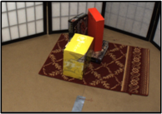

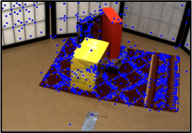
Example: EFFEX Feature Extraction
[Clemons, Austin]
Typical computer vision pipeline
Contextual Scene Reasoning
Contextual Scene Reasoning
Spatial-Temporal Relationships
Spatial-Temporal Relationships
Feature Extraction
Object Geometric & Semantic Reasoning
Local Features, Global Features
Object Geometric & Semantic Reasoning
Feature Extraction
Local Features, Global Features
Feature Extraction
Image
Preprocess image
Scan image for potential feature locations
Filter feature locations
Generate signature of confirmed features
Post process feature descriptors
Local Features, Global Features

Slide 17
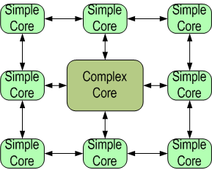
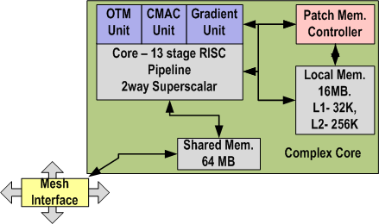
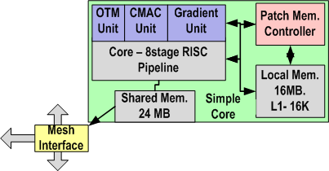
Example: EFFEX Feature Extraction
Vector Reduction Units
Patch Memory
Heterogeneous Multicore
Initial EFFEX design
  90x greater efficiency for feature extraction algorithms
Notes:
If you are reading this note, you are probably awesome. Use the word sliding window here.

Slide 18
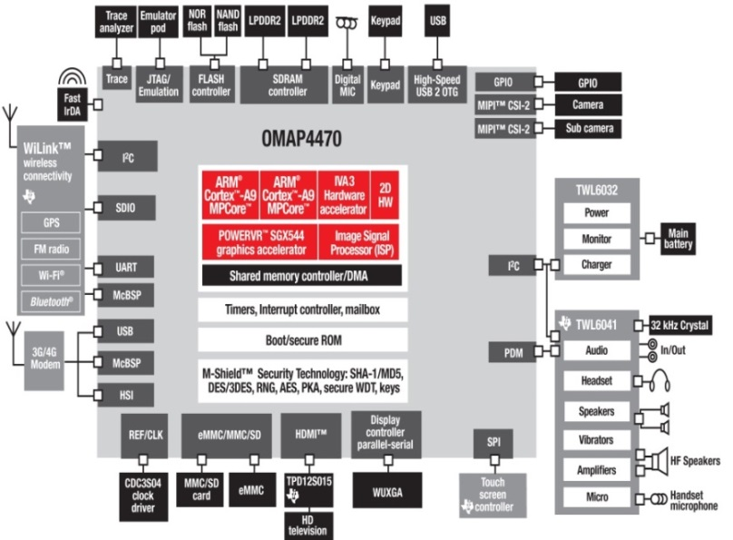
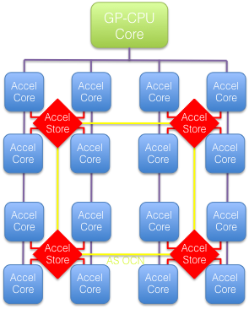
Moving Beyond Homogeneous Parallelism
Many-core designs, while helpful, will soon realize their (perhaps full) potential, what big ideas are next that can translate innovation into scaling
Heterogeneous parallelism is the key to 10-100x energy-efficiency gains in light of slowing silicon
  C-FAR seeks sustained scaling through highly reusable composable customization, and affordable design and manufacturing

Slide 19
The Policy Makers?
Perhaps, while solutions exist, policy
makers do not have the will to support
research into solving this problem
Not the case, while all of the engineering sciences have been hit with funding cuts in the last decade
  Computer engineering has faired better than many other engineering sciences
  Investments in CE research are still flowing from industry and goverment
Example: Center for Future Architectures Research (C-FAR)
  27 PIs from 14 US universities
  US$30M investment over 5 years

Slide 20


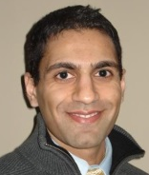



C-FAR: Center for
Future Architectures Research
Sponsored by SRC/DARPA
Goal: Innovation-based scaling for 2020-2030’s
Viability Themes
Computation
(David Brooks)
Applications-to-Architectures
(Krste Asanovic)
Resilient System Design
(Valeria Bertacco)
Design Themes
Communication
(Margaret Martonosi)
System Integration
(Naveen Verma)
What solutions
are needed?
Storage
(Steven Swanson)
Will our ideas actually work?

Slide 21
The Blame? Cost of Design
The one idea I want to leave with you today…
Successfully bridging the Moore’s Law Performance Gap is less about “How” to do it, and more about “How Much” does it cost to attempt to do it
My claim: if we can effect a 100x reduction in the cost to bring a design to market, performance challenges will eventually solve themselves as the market flourishes with orders of magnitude more designs, some of which will be the big design wins of tomorrow

Slide 22

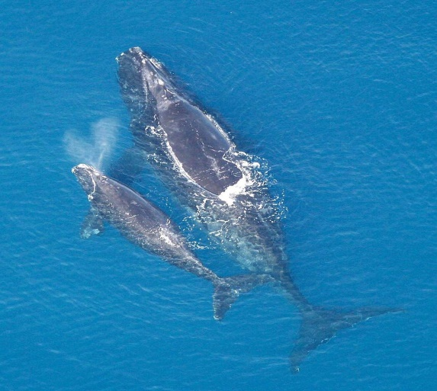
Don’t Believe Me?
Well, you can’t argue with Mother Nature!
  r/K selection theory is a biological mechanism that organisms use to better adapt to their environment
In unstable environments, r-selection predominates as the ability to reproduce quickly is crucial
In stable environments, K-selection predominates as the ability to compete successfully for limited resources is crucial

Slide 23
Design Costs Are Skyrocketing
Source: International Business Strategies
23

Slide 24
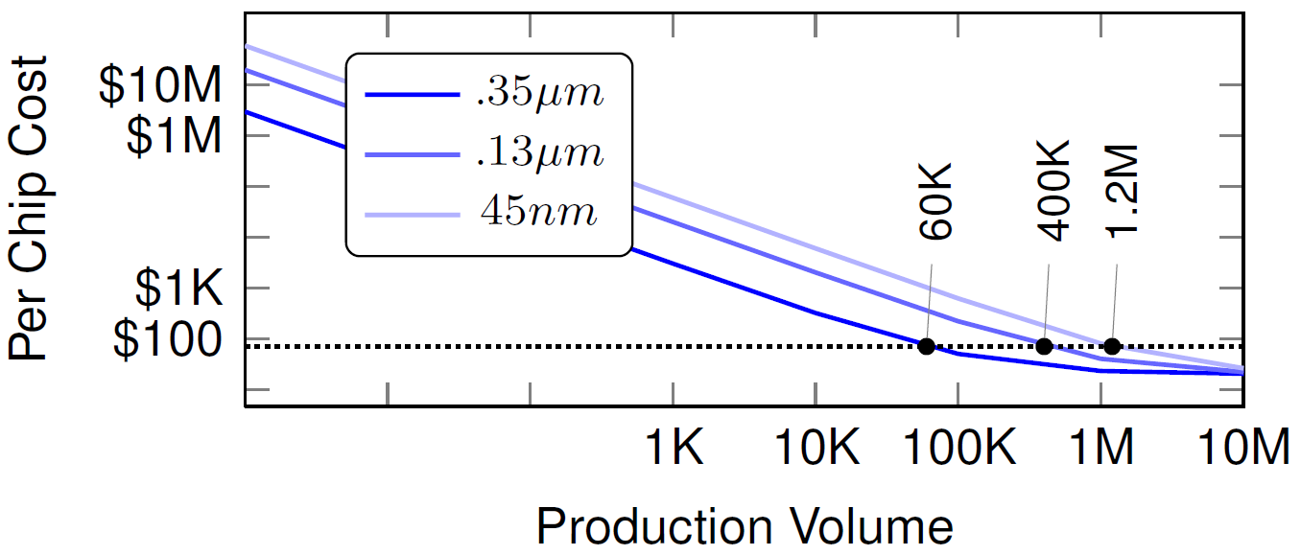
High Costs Kill Innovation
Heterogeneous designs often serve smaller markets

Slide 25
Outcome: “Nanodiversity” is Dwindling
Source: Gartner Group
25

Slide 26

Silicon Today:
The Good, the Bad and the Ugly
The Good: Moore’s law will continue for the near future
  It won’t last forever, but that another problem
The Bad: Dennard scaling has all but stopped, leaving innovation to fill the performance/power scaling gap
  E.g., app-specific design, custom accelerators
The Ugly: Hardware innovation requires design diversity, which is ultimately too expensive to afford
  Skyrocketing NREs will necessitate broadly applicable (vanilla and slow) H/W designs

Slide 27

The Remedy:
Scale Innovation via Lower Design Cost
Ultimate goal: make customized design sufficiently inexpensive that anyone can do it anywhere
  Address all NRE factors: market size, design costs, build costs
  Take inspiration from Web 2.0, and subsequent innovation explosion
Approach #1: Reduce the cost of custom hardware
  With better tools that understand and leverage the benefits of customization
  By embracing open-source hardware design solutions
Approach #2: Widen the applicability of custom hardware
  Increasing market applicability with composable customization mitigates potentially higher NREs
Approach #3: Reduce the cost of manufacturing hardware
  Utilize assembly-time customization to slash the cost of customization
Approach #4: Slash software development costs
  Through more effective reuse, wider adoption of open source technologies, and novel approaches to verification

Slide 28
1) Reduce the cost of custom hardware
Better tools
  Scalable accelerator synthesis and compilation, generates code and H/W for highly reusable accelerators for a wide range of applications
  Composable design space exploration, composability permits novel search techniques based on machine learning, enables efficient exploration of highly complex design spaces
Embrace open-source concepts
  Example: Berkeley’s RISC-V architecture
MxPA/FCUDA
RTL
Composed
design space
automatic composition
CPU, GPU, Accelerator Design Spaces

Slide 29

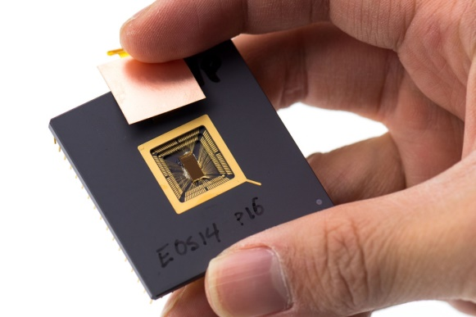
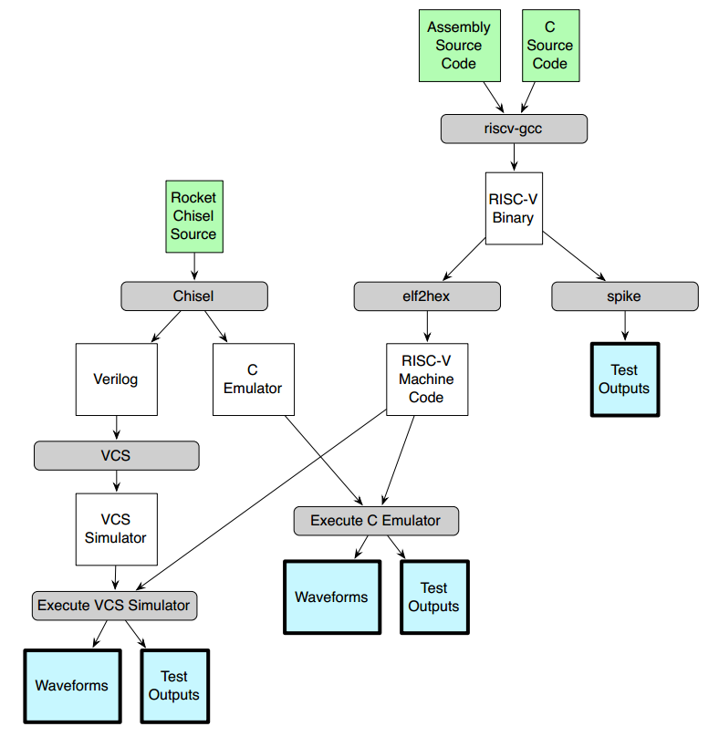
Berkeley’s RISC V Open-Source ISA

Slide 30
2) Widen the Applicability of Custom H/W
[Asanovic, Keutzer]
Computer Vision
Multimedia Analysis
Machine Learning
Applications
…
Computational Patterns
Dense
Sparse
Graph
Specializers with custom implementations and autotuning
Glue Code
Dense Code
Sparse
Code
Graph Code
ESP Code
ILP Engine
Dense Engine
Sparse Engine
Graph Engine
ESP Core
ESP: Ensembles of Specialized Processors
  Ensembles are algorithmic-specific processors optimized for code “patterns”
  Patterns capture common operations across many applications, each with unique communication and computation structure
  Approach has the promise of custom accelerator speed and efficiency that is widely applicable to general purpose programs

Slide 31

3) Reduce the cost of manufacturing H/W
[Bertacco, Carloni, Mercaldi]
Brick-and-mortar silicon explores assembly-time customization, i.e., MCMs + 3D + FPGA interconnect
Diversity via brick ecosystem & interconnect flexibility
Brick design costs amortized across all designs
Robust interconnect and custom bricks rival ASIC speeds
Brick-and-mortar silicon
design flow:
Assemble brick layer
Connect with mortar layer
Package assembly
Deploy software
H/W brick
31

Slide 32
4) Slash Software Development Costs
Implement more software reuse
Embrace more fully the open-source movement
Audience, other ideas?

Slide 33



Conclusions
Heterogeneous design could continue Moore’s law scaling through innovation alone
  But, it requires a diverse hardware ecosystem with affordable customization
Affordable customization won’t happen without our help
  Widen the applicability of customization
  Reduce the cost of customized design
  Reduce the cost of custom manufacturing
Resulting “nanodiversity” is a good thing
  Better perf, power, cost, capability
  More jobs, companies, and students
  More competition and scalable innovation

Slide 34
Questions
?
?
?
?
?
?
?
?
?
?
?
?

